Slide 1

Personal Income & Expense Management System
Project Name:

Slide 2
Introduction
Application is intended to manage the income and expenses of a family. Will provide an easy interface to enter day-to-day income & expenses.
Will provide options to add custom categories of income & expenses .
Will have options to set up recurring expenses for example electricity, mobile, cable, etc.. monthly payments.
Will provide various reports to see the income & expenses grouped by various categories. For example on datewise, monthwise, yearwise , etc…
Income & Expense Management System designed to efficiently cater the needs of users by eliminating imparting cost.
Income and & Expenses Management System are web based applications to manage their income and expenses.

Slide 3
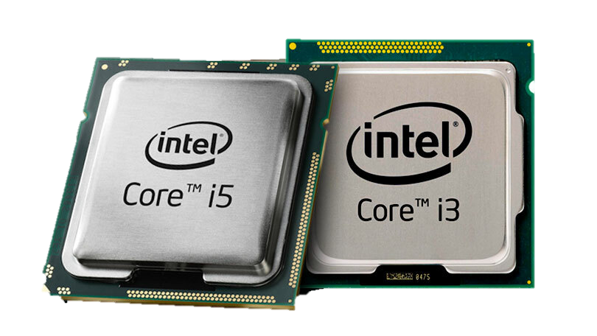
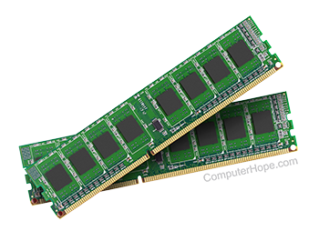
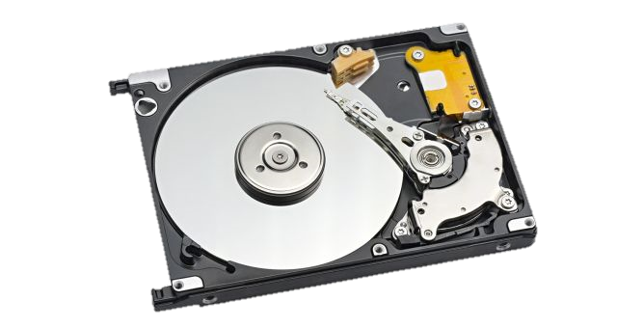

Hardware Requirement
System Requirement
Windows OS
4GB+ RAM
32GB+ Storage
Processor – Intel i3 & i5

Slide 4







Software Requirement
VS Code
Xampp
Apache
MySql
Google Chrome
Language Used:
HTML & CSS
PHP
JavaScript

Slide 5
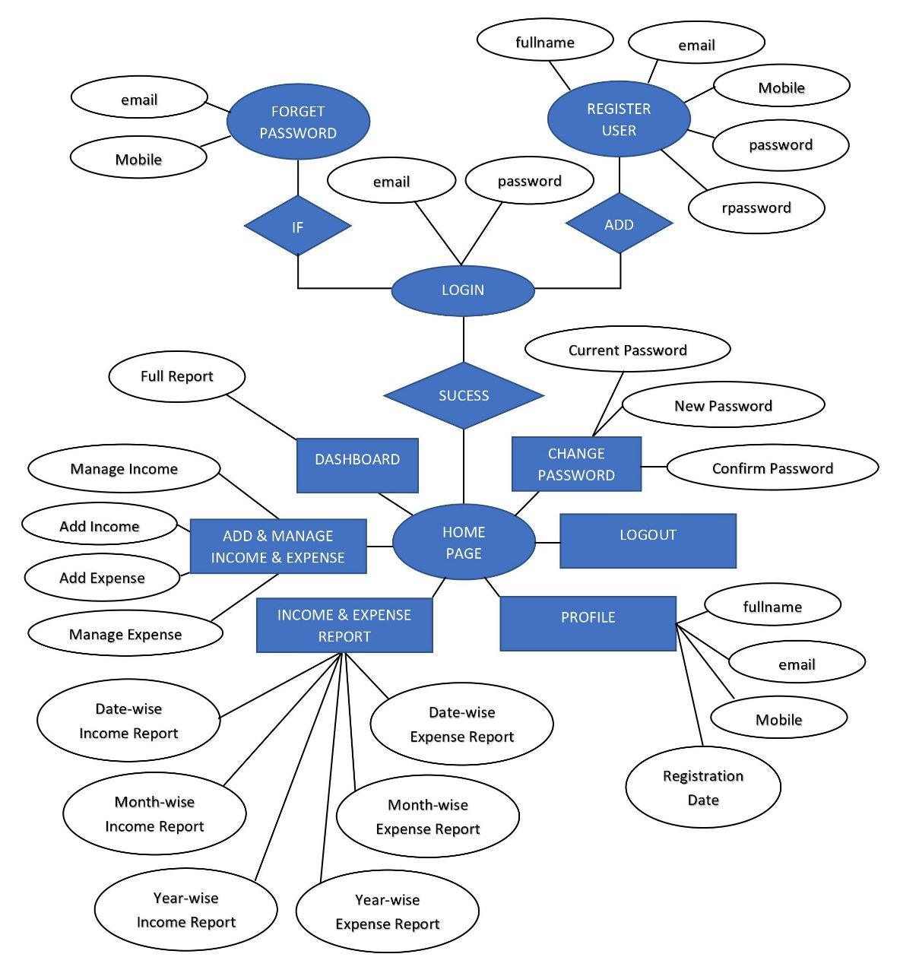
System Design
Entity Relationship Diagram

Slide 6
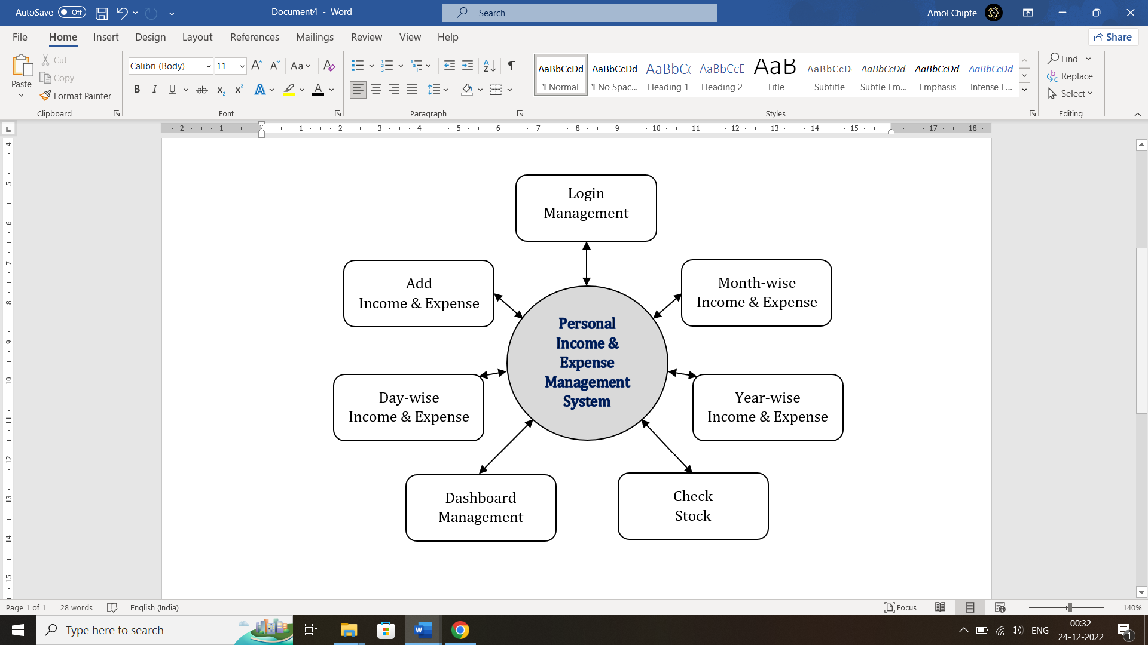
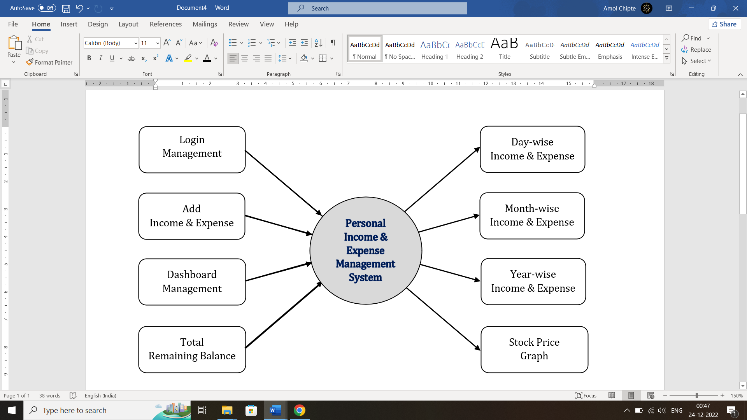
Data Flow Diagram
0th Level DFD
1th Level DFD

Slide 7
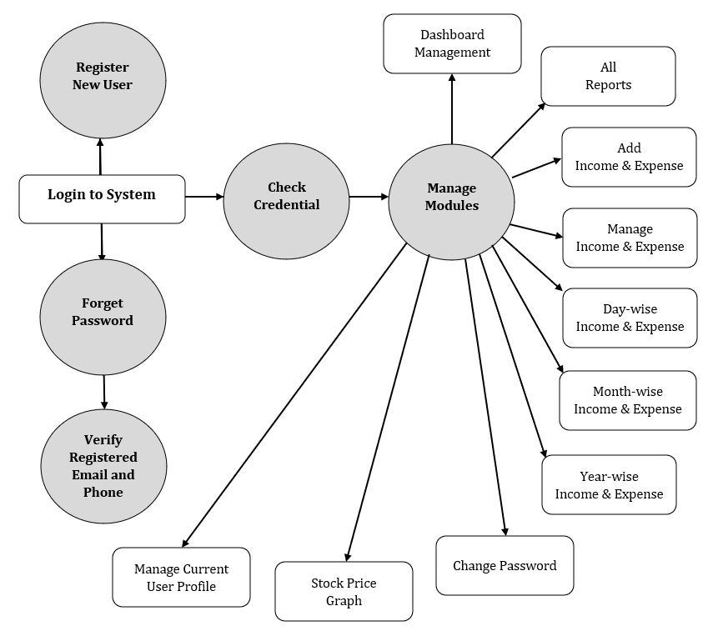
2th Level DFD

Slide 8
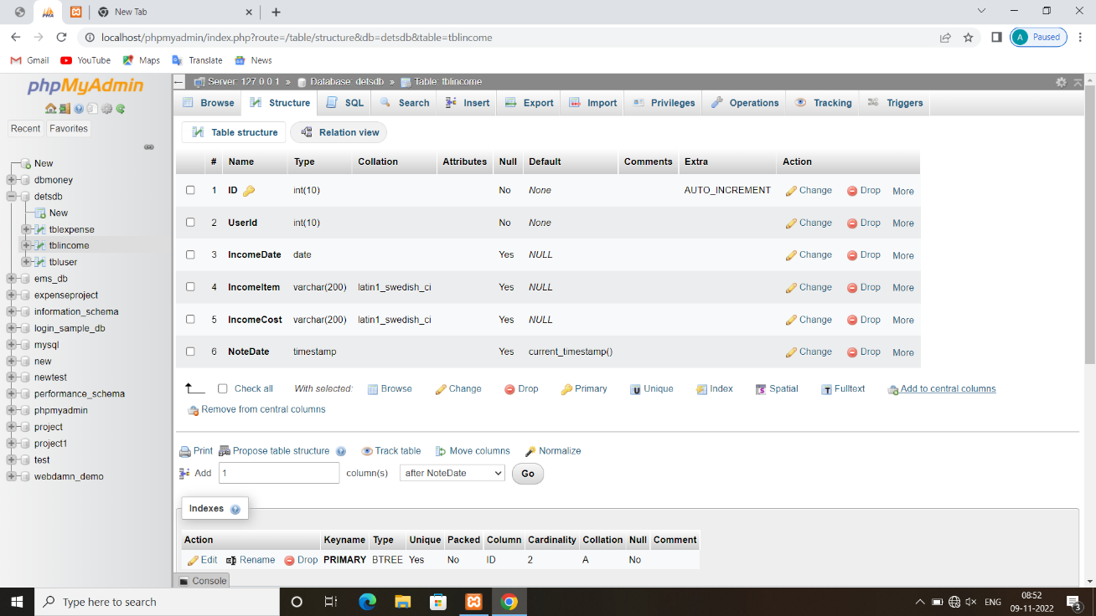
Database Design
Table Design
Income Table

Slide 9

Expense Table

Slide 10
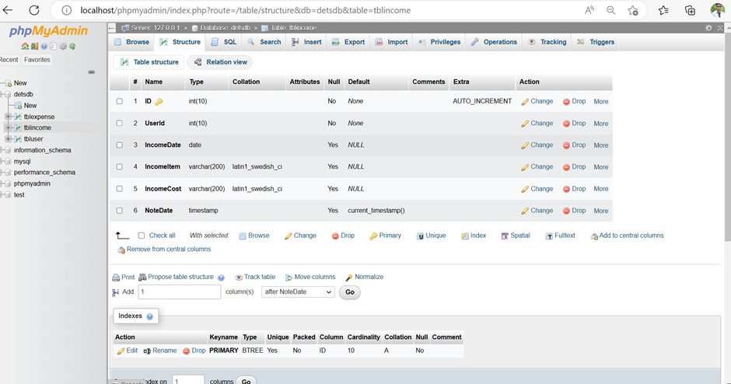
User Table

Slide 11
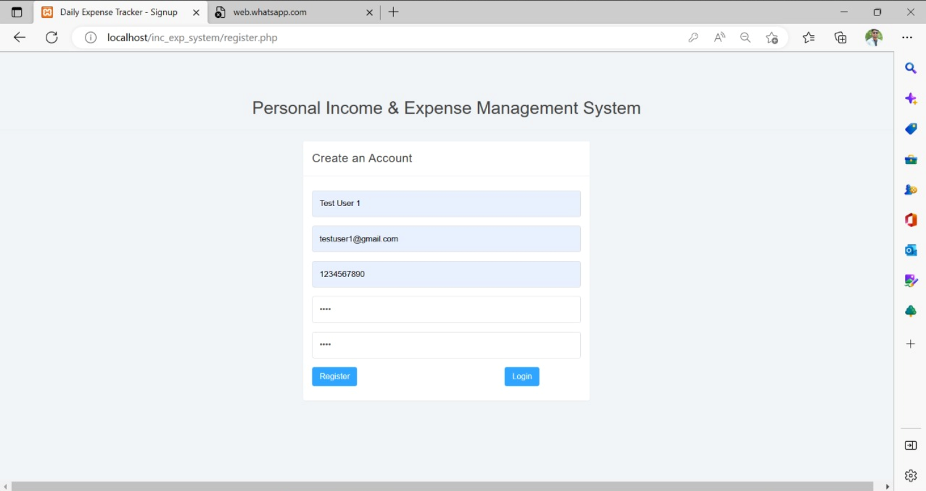
Screenshots
Login
Register User Page

Slide 12
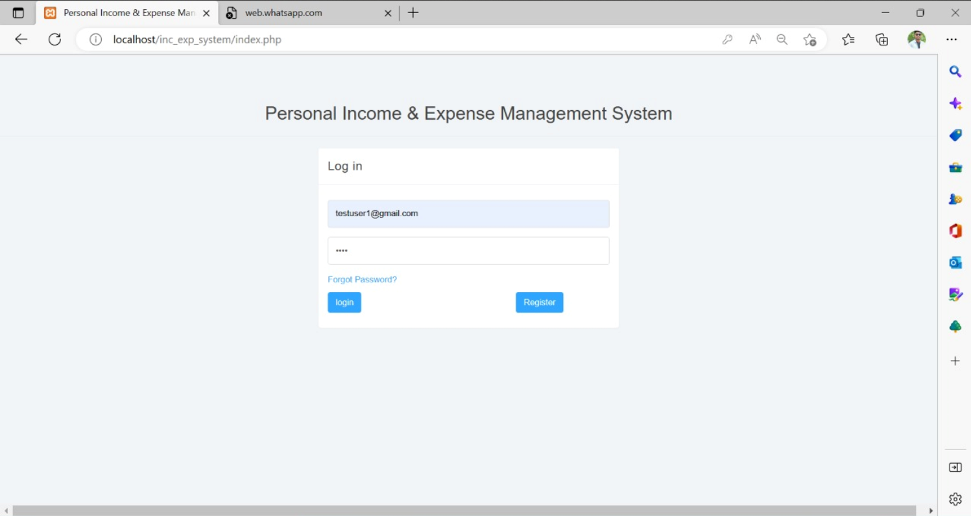
Login
Forget Password
User Login Page
Register
23

Slide 13
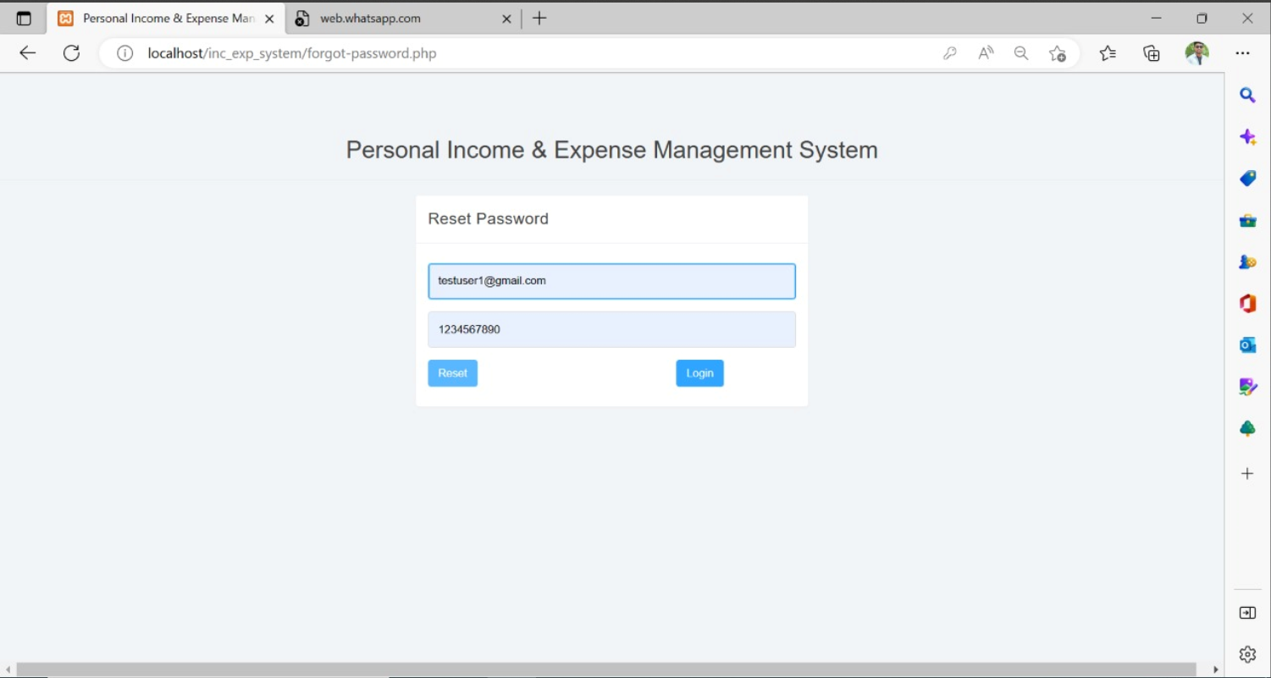
Login
Forget Password Page
Reset

Slide 14
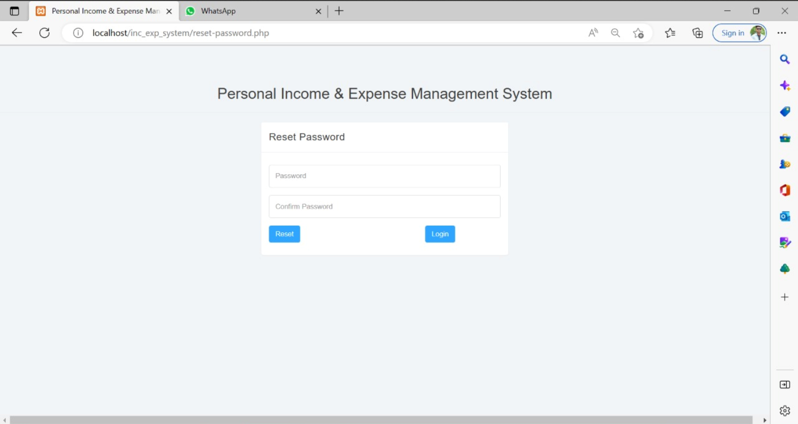
Reset &Login
Reset Password

Slide 15
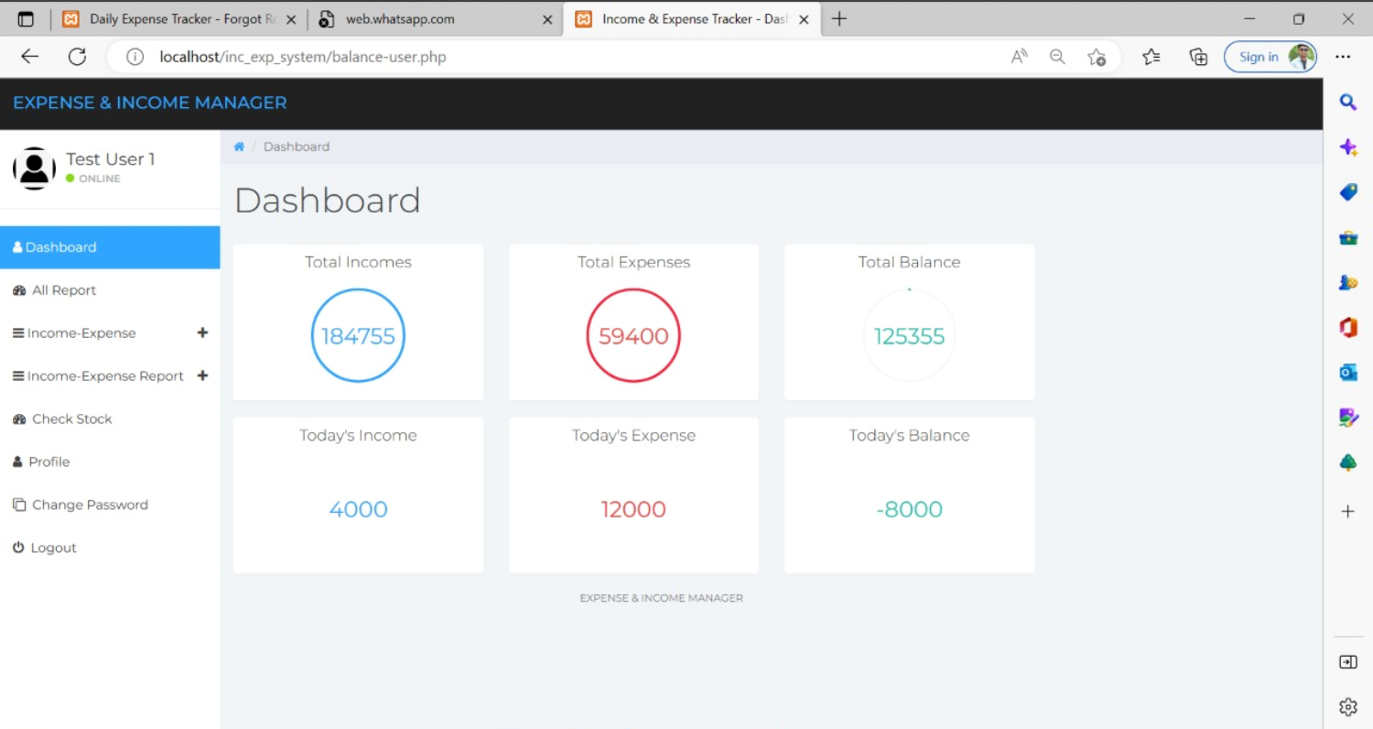
User Dashboard

Slide 16
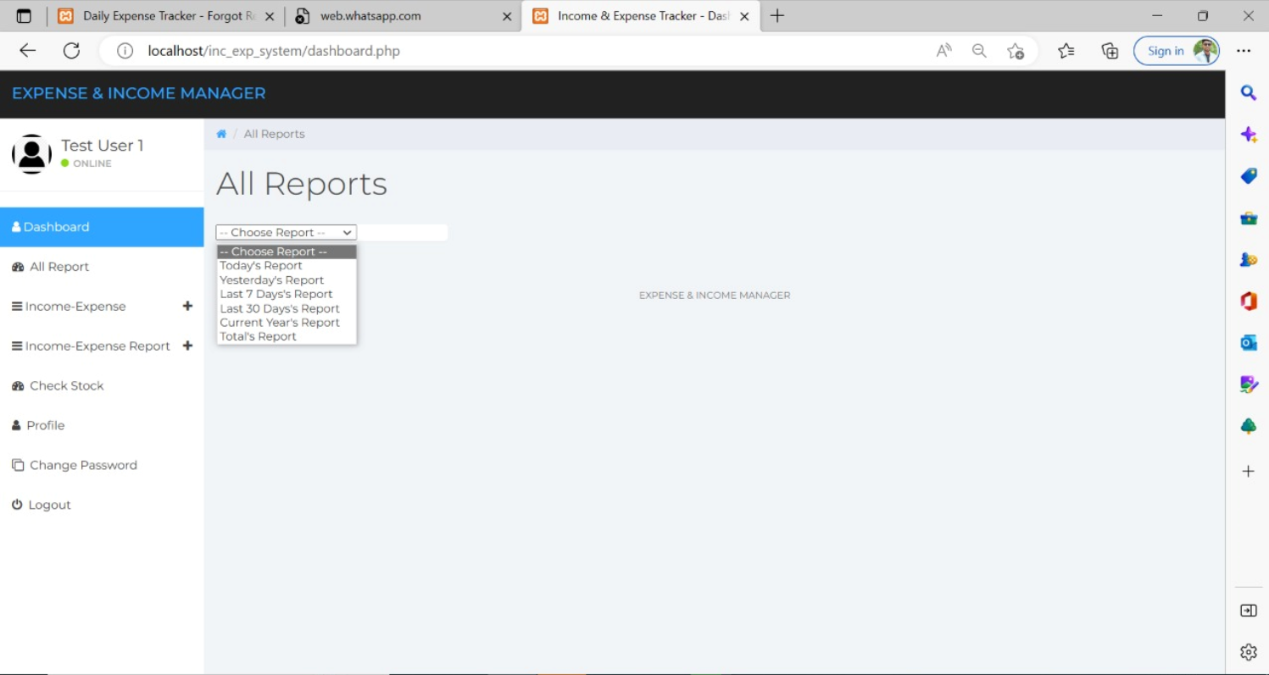
All Reports

Slide 17
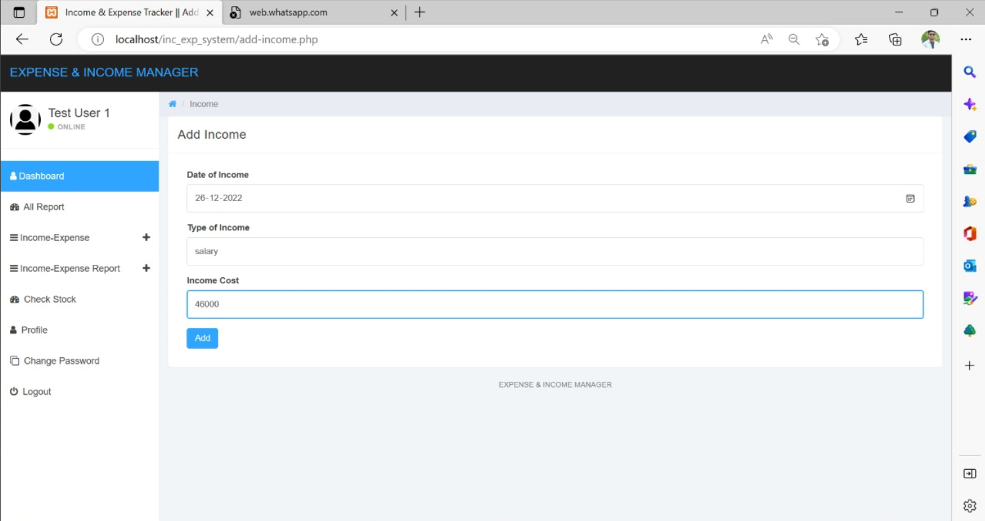
Add User Income Page

Slide 18
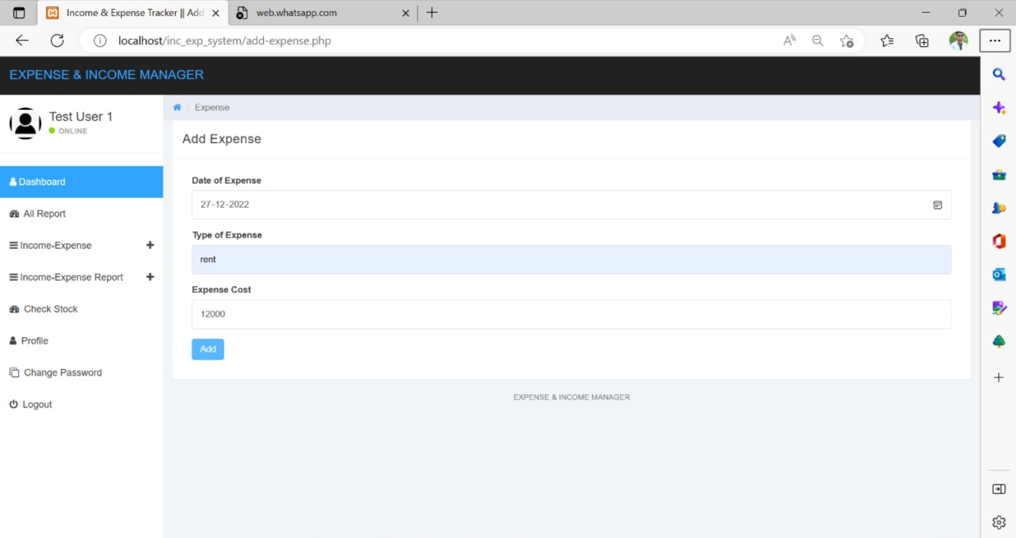
Add User Expense Page

Slide 19
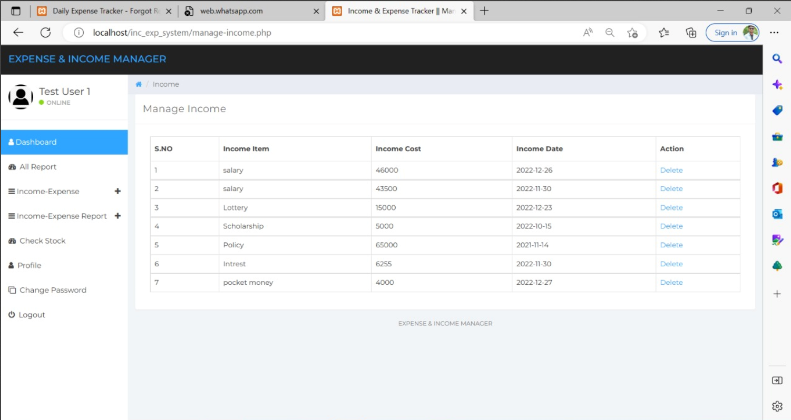
Manage Income Page

Slide 20
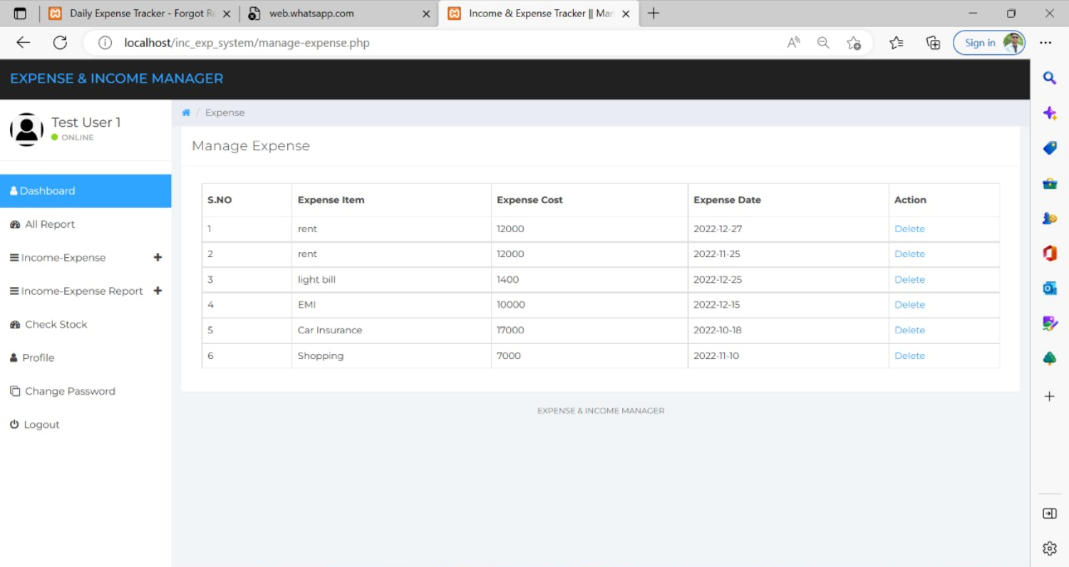
Manage Expense Page

Slide 21
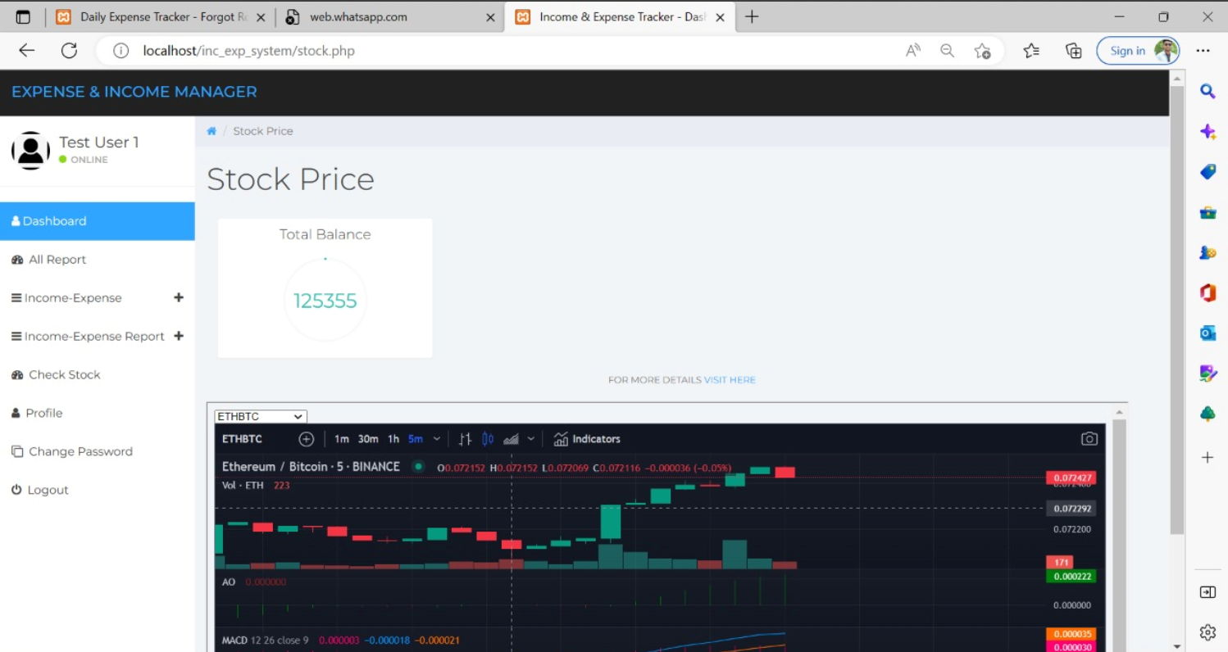
Check Latest Stock

Slide 22
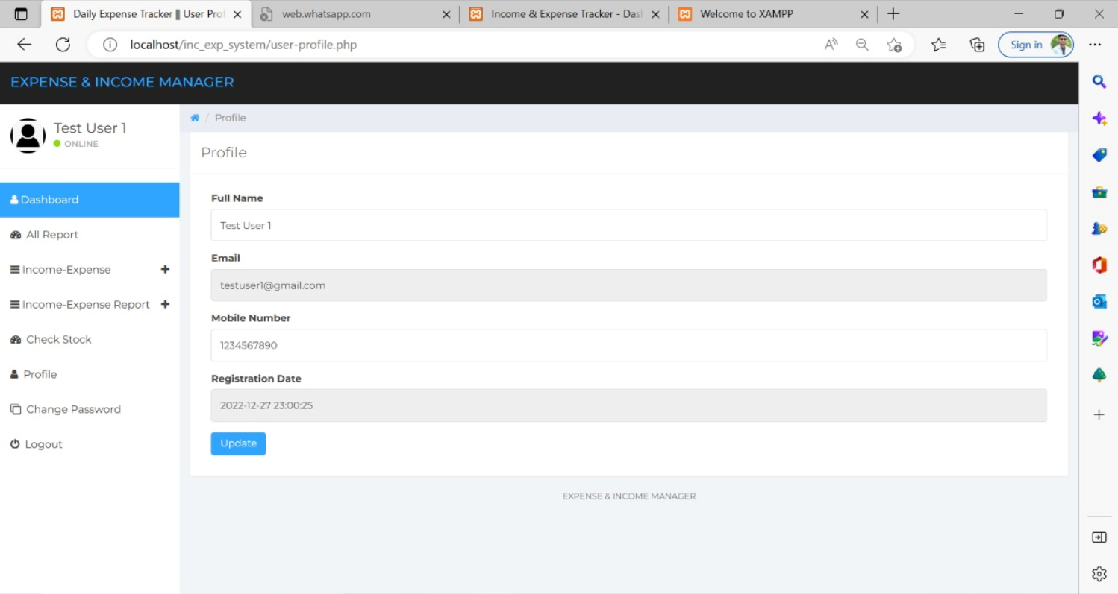
User Profile

Slide 23
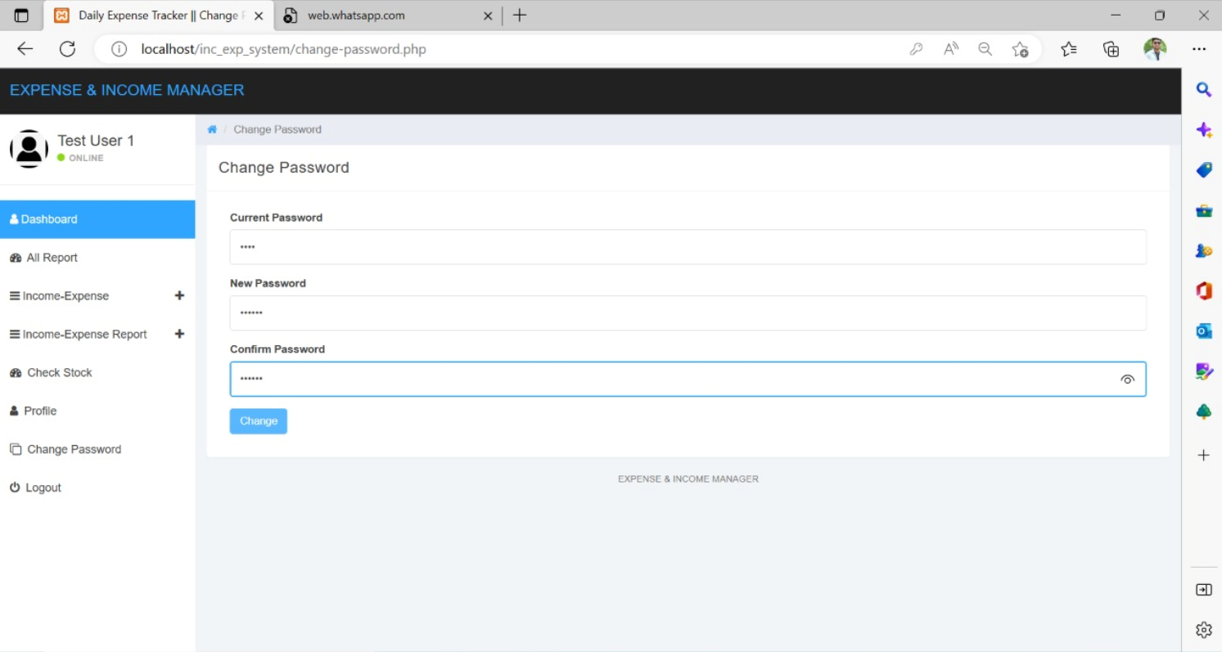
Logout
Change Password

Slide 24
Report
It generates the report on Income, Expense, Category, Payment
Provide filter reports on Type, User, Registration.
You can easily export PDF for the Income, Expense, Payment.
It is Flexible to use.

Slide 25
Modules
Income & Expense Management Module: Used for managing the Income & Expense details.
Registration Module: Used for managing the details of Registration
Check Stock Module: Used for Show Live Stock Graph.
Category Management Module: Used for managing the information and details of the Category (Day-wise, Month-wise, Year-wise and Custom Dates).
Type Module: Used for managing the Type of Income and Expenses details
User Module: Used for managing the User information
Login Module: Used for managing the login details

Slide 26
Conclusion
User Friendly- The system has got much simplified screen which makes the system fast enhances quick and accurate data.
Validation check- The system has various validation checks, and it also gives appropriate error message and provides the necessary help.
Report Generation- The system can generate various reports giving income details and expense details.
Easy to Learn- This system is easy to understand and this thing is mainly due to simple functionality.
Simple Interface- As it provides best and easy way to understand whole project in simple way. So user can use it as it want.

